Slide 1
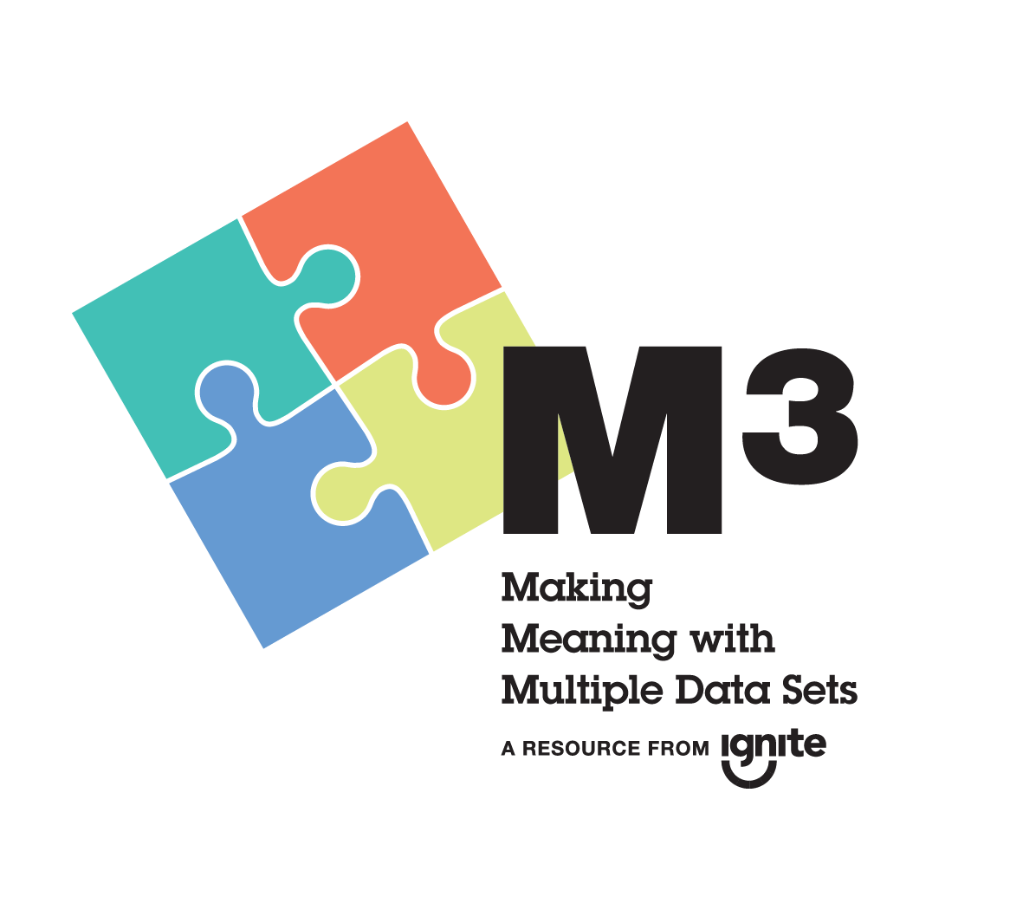

Notes:
Maira:
Welcome to the Making Meaning with Multiple Data Sets Information Session.
Thanks for your continued commitment to improving programs and outcomes for young people in your organizations and communities.

Slide 2

Notes:
Maira:
The session is part of Ignite Afterschool’s Believe It. Build It. Minnesota’s Guide to Effective Afterschool Practices (also affectionately nicknamed BiBi) project.

Slide 3
Notes:
Maira:
We’ll get back to Ignite Afterschool and Believe It. Built It. in a second.

Slide 4

Maira Rosas-Lee
Results Measurement Specialist
MN Dept. of Education
Notes:
Maira:
First allow me to introduce myself…
(click)

Slide 5
Eric Billiet
Expanded Learning Specialist
MN Dept. of Education
Notes:
Maira: and now I’d like to introduce Eric Billiet …
Eric:
Hello. Thank you Maira.
As the Expanded Learning Specialist, my main role is to provide Administration and Technical Assistance for the 21CCLC grant program. I also provide TA for other out of school time initiatives and help facilitate the MYC’s SAC to MDE.
Although we are here representing MDE, we are also representing Ignite Afterschool. MDE is a partner organization of Ignite Afterschool.
But I’m more than just a title…
(click)
Despite my windblown hair, I like this picture because it captures the uniqueness of the town I graduated from. Lutefisk Capitol USA!

Slide 6
Notes:
Eric:
Now we’d like to get to know each other. At your table, please introduce yourself, your organization, and something your home town is famous for.

Slide 7

Inspiration for today
Aspiration for tomorrow…
Notes:
Maira:
In a nutshell? The session is meant to help us find “Inspiration for today & aspiration for tomorrow”. Each of us comes at evaluation from a different place and that’s okay. This session is meant to be a introduction to how Ignite Afterschool supports the afterschool field to use data to strengthen programs and make a positive difference for young people.

Slide 8

Today, you will…
  Meet Ignite Afterschool
  Overview M³
  Identify Action
Notes:
Eric:
Today you will…
Become familiar with Ignite Afterschool and Believe It. Build It. content and resources
Learn how M³ fits into Ignite Afterschool’s Continuous Improvement Cycle
Identify action to integrate (or accelerate) Continuous Improvement processes within your program and organization.
(click)
Let’s start with Ignite Afterschool…

Slide 9

Notes:
Eric:
Ignite Afterschool is where M³ lives and many of you have met Ignite but some of you have not.– anyone new to Ignite at this session? Anyone who is familiar want to share?

Slide 10

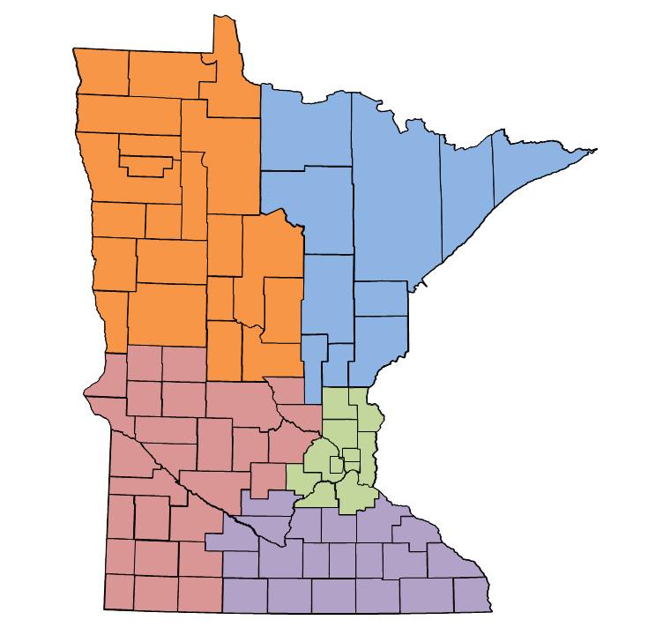
Who is Ignite Afterschool?
Promoting access to quality afterschool through:
Policy
Quality
Partnerships
Notes:
Eric:
MN’s Afterschool Network dedicated to advancing high-quality afterschool and summer learning programs for all youth. The network includes associations of YMCAs, Boys & Girls Clubs, United Way, Community Education, Recreation and Parks, MN School Aged Child Care, and many more.
Vision: Every Community, Every Youth
Part of National Network of State Afterschool Networks funded in part by the Mott Foundation
(click)
As Minnesota's statewide afterschool network, Ignite Afterschool works with afterschool stakeholders all across Minnesota to ensure we truly speak with a statewide voice. To keep the network connected, Ignite relies on 4 Regional Igniter partner organizations in Greater Minnesota, as well as the citywide systems in the Greater Twin Cities metro area.
(click)
Ignite works collaboratively to Ignite the Power of Afterschool in three main areas:
Policy, Quality, Partnerships
M³’s is a combination of Ignite’s work in Quality & Partnerships
It brings together allies in afterschool from each region of the state to support equitable access to evaluation capacity building opportunities for youth workers.

Slide 11

We Believe Statements
Building Blocks
Continuous Program Improvement Cycle
Guided Reflection
Acknowledgements & Resources
Notes:
Eric:
Back to Believe It. Build It. The idea for Believe It. Build It. was to ensure everyone across the state who works in afterschool (school, library, rec center, CBO) has access to what research tells us are the key elements of a program that lead to better outcomes for kids.
A little background on Believe It. Build It.
Folks from around the state came together for a daylong session to look at other states, other countries and pull out the key values, effective practices and elements of a continuous program improvement cycle.
We dug into the current research and made it fit for Minnesota.
We wanted something super accessible, free, inspiring to use.
After a few cycles of drafts and feedback, BiBi was born.
(click)
These are the components of Believe It. Build It.

Slide 12

Every young person deserves opportunity to realize
their fullest potential. We provide many different ways
and places for young people to learn so they can develop
their talents and ignite their passions.
Young people have many strengths, abilities and
assets. We value youth voice, leadership, and the many
meaningful contributions young people make to our
community.
Afterschool programs are important and impactful.
When we are intentional about quality, our work
positively impacts young people’s growth and
development.
Community, family and culture are fundamental to a
young person’s identity. We create welcoming, inclusive
environments where young people of all backgrounds
and abilities can feel safe, freely express and discover
their identity, and belong to a supportive community
of peers and adults.
We are stronger together. Whole communities must
act together to provide the full range of resources and
experiences young people need to be successful.
Notes:
Eric:
The very first thing we did when we started developing BiBi was to identify the shared beliefs and principles that ground youth work in Minnesota and distinguish “afterschool youth development” from other approaches to working with young people.
Often times we just jump into program and activity planning without taking any time to get clear with our team about the underlying values of our organization or our “field” as folks in youth development & afterschool. This can be very important when we ask staff to be intentional about their youth work practice.
In BiBi, we crafted “We Believe” statements that cut across programs and many afterschool programs find synergy with. We also recognize that organizations may have additional values that guide their work.

Slide 13

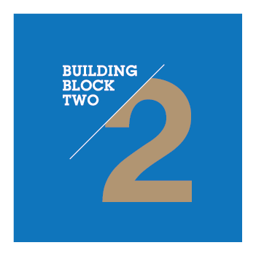

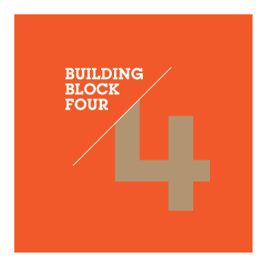


Building Blocks
Intentional
Program
Design
Supportive Relationships & Environment
Youth Voice
& Leadership
Responsiveness to Culture & Identity
Community
& Family Engagement
Organizational Management, Staff Support & Youth Safety
Notes:
Eric:
In the BiBi design process, our partners dug into research to really understand what practices were critical in designing and delivering high quality programs that positively impacted young people.
After hundreds of post-its notes and hours of shuffling and sifting and sorting, we identified 6 basic categories that build high-quality programs
And then we did hours more of shuffling and sifting and sorting to build each of those 6 categories out with a list of research-based effective practices that can be used to shape programs

Slide 14
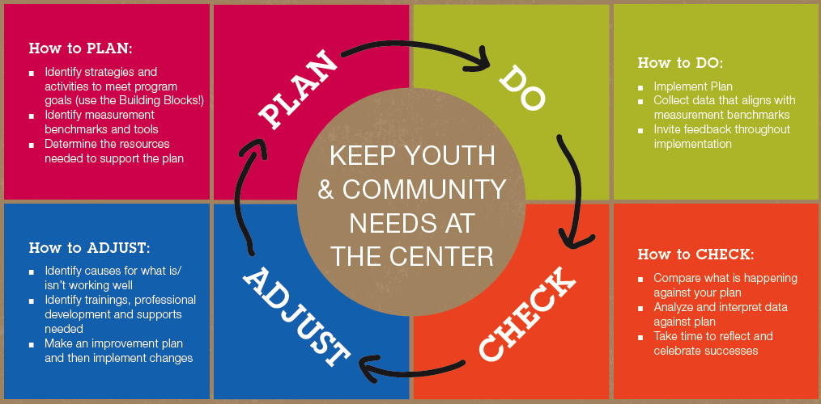
CONTINUOUS PROGRAM IMPROVEMENT
Notes:
Eric:
This section is really about the “Now What?” – Now what do we do with all this good information around effective practices? It’s one thing to know what goes into building an effective program and another thing to continuously make it happen. It’s the framework that puts the Building Blocks to use.
Research tells us that when programs continue to systematically and intentionally evaluate and focus on improvements (not just once a year at a meeting, but as regular practice) - there is better potential for quality. And when quality improves, outcomes improve.
Believe It. Build It.’s Continuous Program Improvement model is a cycle. It’s important that you have some kind of plan. That you check on how your program is doing compared to that plan, and start planning the adjustments we’d like to make. Once you start implementing those adjustments in your programming, you’re in back in the doing phase.

Slide 15

THAT’S BiBi FOLKS!
Notes:
Eric:
Congratulations! That’s an introduction to Ignite Afterschool’s Believe It. Build It.
At your tables, please spend a few minutes discussing:
Any surprises?
Any “ah-ha”s or “I hadn’t really thought about that”s?
How might you use Ignite Afterschool’s Believe It. Build It.: Minnesota’s Guide to Effective Afterschool Practices.?
Any questions?

Slide 16
Today you will…
  Meet Ignite Afterschool
  Overview M³
  Identify Action
  Meet Ignite Afterschool
Notes:
Eric:
Now that we’ve had an introduction to Ignite Afterschool’s Believe It. Build It. …
(click)
… let’s dive into the overview of M³

Slide 17



M³ ORIGINS
Notes:
Eric:
First I’d like to acknowledge the partners in the original M³ design in 2014. M³ was created and designed by a partnership between the Minnesota Department of Education, the Minneapolis Beacons Network, and Sprockets (the Saint Paul city-wide afterschool system).
M³ planning started with two goals.
To better align the data collection and reporting processes across community, city, and state levels.
To increase the evaluation capacity of programs to utilize formative data for program improvement, rather than just collecting summative data for funder reports.
It was designed to meet needs across the state and has gone through several iterations, and now “lives” at Ignite Afterschool Network.

Slide 18

M³
Notes:
Maira:
M³ is a 6 hour workshop where teams from an afterschool program or youth serving organization go through a facilitated process with multiple sets of data individually first, then converge them while looking for themes to emerge, and then begin continuing improvement action planning.
If you are someone who works in the afterschool field, then M³ is for YOU!
(click)
That’s great about M³ is that it is very user friendly. You can do it if you’ve never thought deeply about using data or if you’ve been doing it along time.
It’s tool neutral. It compliments any assessment tools you already use and can be used with any tools you decide to pick up in the future. You can use numerous assessment tools and incorporate that data into the CPI during M³.
It does require programs review the BiBi guide and become familiar with the Building Blocks of effective practices and CPI. It’s one thing to know what goes into building an effective program and another thing to continuously make it happen.
It is not a stand alone workshop. It needs to be imbedded into a CPI Framework. It’s the framework that puts the Building Blocks to use.
Before we get into the data, we want to share a bit about the framework.

Slide 19
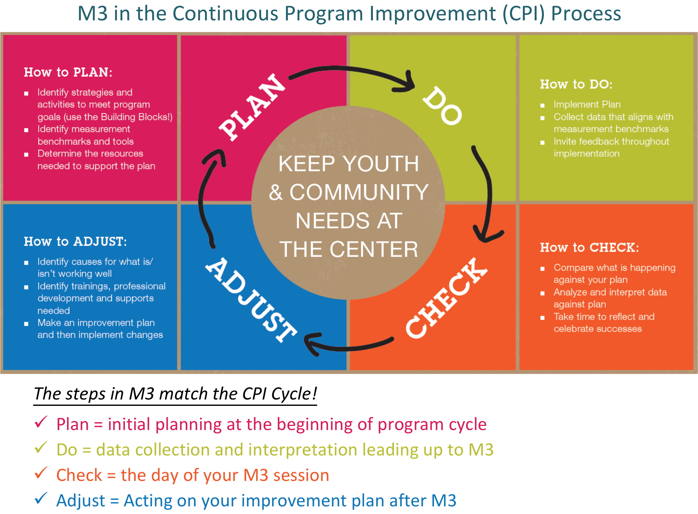
Notes:
Maira:
When programs commit to CPI like you have, they systematically and intentionally evaluate and improve their program practices. M³ is a guided process to support you in this.
The objectives of M³ are
to increase participants skills to make meaning of multiple data sets in the context of programs and organizations.
for participants to interpret data and create a consolidated program improvement plan.
for participants to identify next steps and actions for continuous program improvement.
The steps in M³ translate to the CPI Cycle as well.
Plan = initial plan to collect data at the beginning of program cycle
Do = collect data leading up to M³
Check = focus on the results at M³ Huddle session
Adjust = Act on your improvement plan after M³
Another critical step is to share your improvement plan with staff and stakeholders at your site, and then start taking action on it!
The M³ process doesn’t stop after the Huddle is over. You keep planning, doing, checking, adjusting with the cycle.

Slide 20
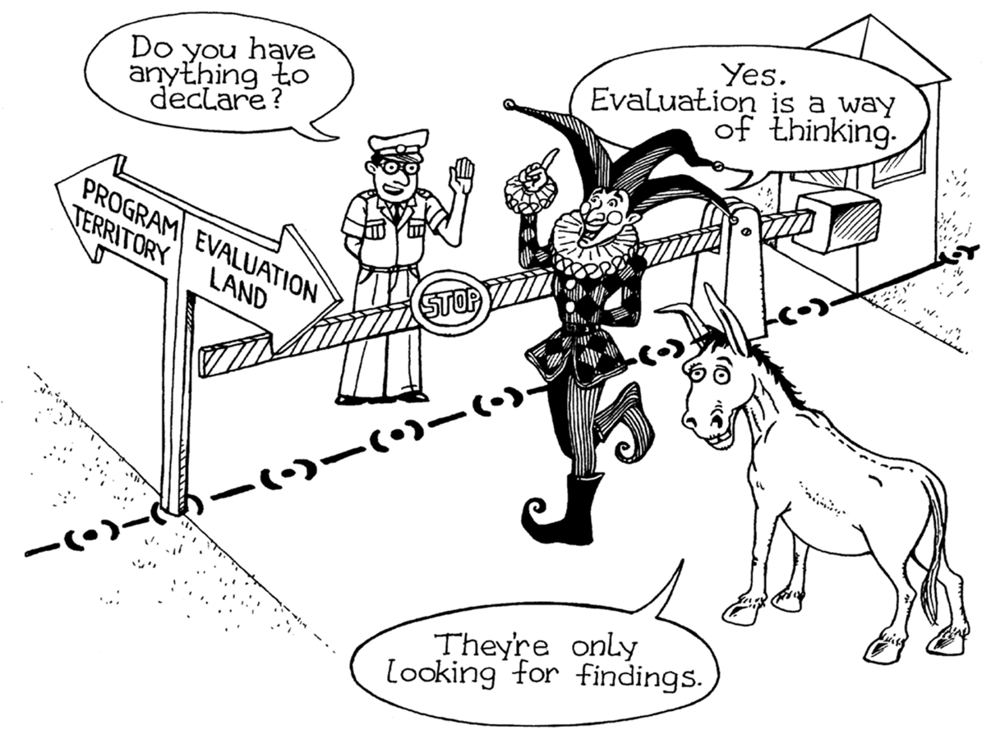
https://tgarchibald.wordpress.com/2013/11/15/evaluative-thinking-lit-review/
Notes:
Maira:
On a larger scale, M³ is about evaluation capacity building by increasing participants Evaluative Thinking skills.
For too long we have operated with evaluation and programming in discrete categories and didn’t cross into the other land with much intention.
We conducted evaluations because findings were required and needed to be “declared.”

Slide 21
Evaluative Thinking
…a cognitive process in the context of evaluation, motivated by an attitude of inquisitiveness and a belief in the value of evidence, that involves skills such as identifying assumptions, posing thoughtful questions, pursuing deeper understanding through reflection and perspective taking and making informed decisions in preparation for action.
Jane Buckley & Tom Archibald, 2015
http://aea365.org/blog/tag/evaluative-thinking/
DOING
EVALUATION
BEING
EVALUATIVE
Notes:
Maira:
Evaluative Thinking breaks down those barriers and shifts from Evaluation as a set of tasks/obligations that need to be done → to a way of approaching and continuously improving the work
We used Jane Buckley and Tom Archibald definition of evaluative thinking. We explain it to programs as…
(click)
We need to move from Doing Evaluation to Being Evaluative

Slide 22

Design Feature: “DATA Buckets”
QUALITY
PRACTICES
PROGRAM
EXPERIENCES
YOUTH
OUTCOMES
ATTENDANCE/
PARTICIPATION
Notes:
Eric:
Another foundation of M³ is the 4 “buckets” of data that are critical to collect:
Collecting these 4 sets of data creates a more full picture and helps make more informed decisions – more of a systems view!
The 4 “buckets” are based on afterschool research.
Research shows that positive outcomes (click) from afterschool programs is contingent on the amount of time students spend (click) in a high quality program (click) that they enjoy and build relationships with caring adults (click).

Slide 23
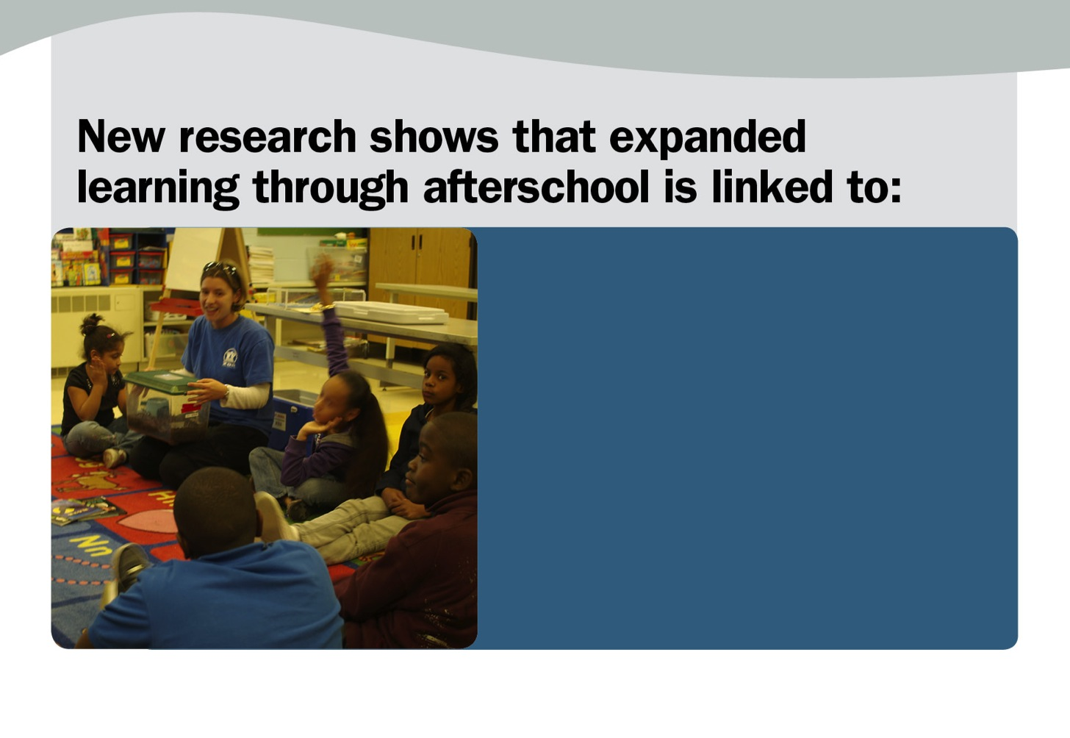
Notes:
Eric:
For example…

Slide 24
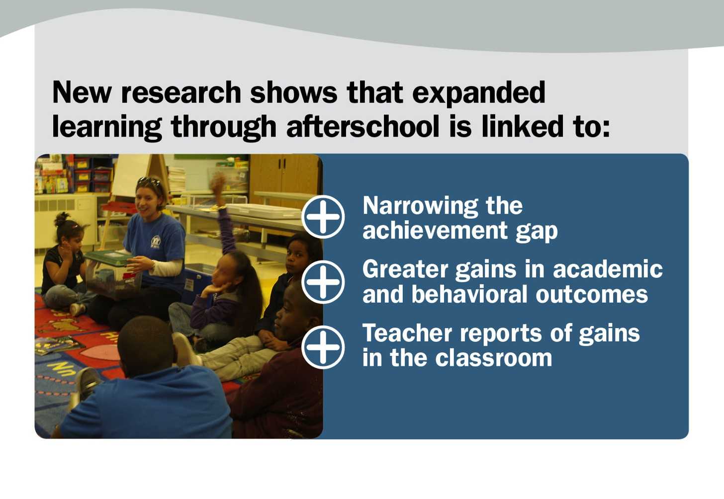
Notes:
Afterschool is linked to gains in what is commonly called “the A.B.C.’s”; improved school day attendance, behavior, and core academics. The A.B.C.’s are the greatest predictor of school success and graduation.

Slide 25
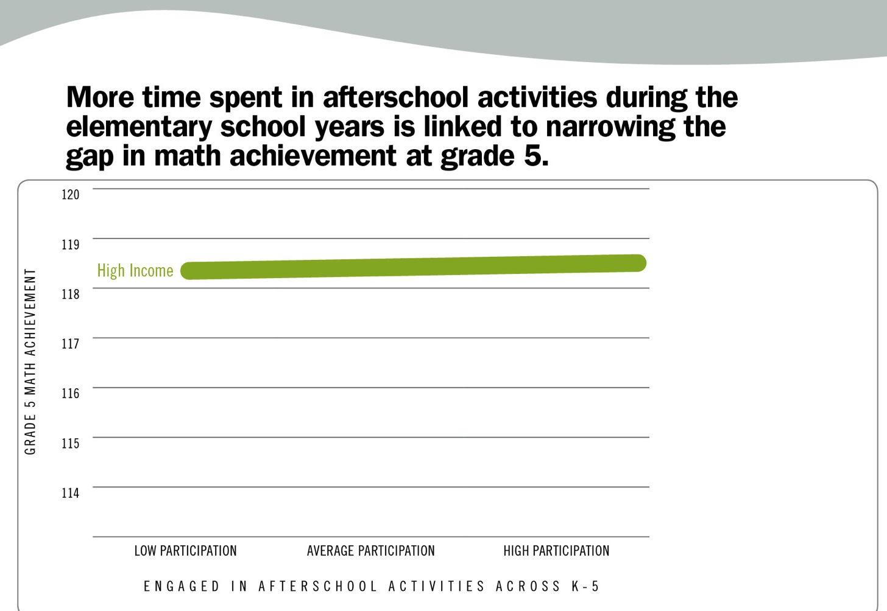
Notes:
Eric:
Let’s look at the link between afterschool participation opportunity gap and the math achievement gap.
We don’t see much difference in scores for high income students as they participate in out of school programs. They are already doing well.

Slide 26
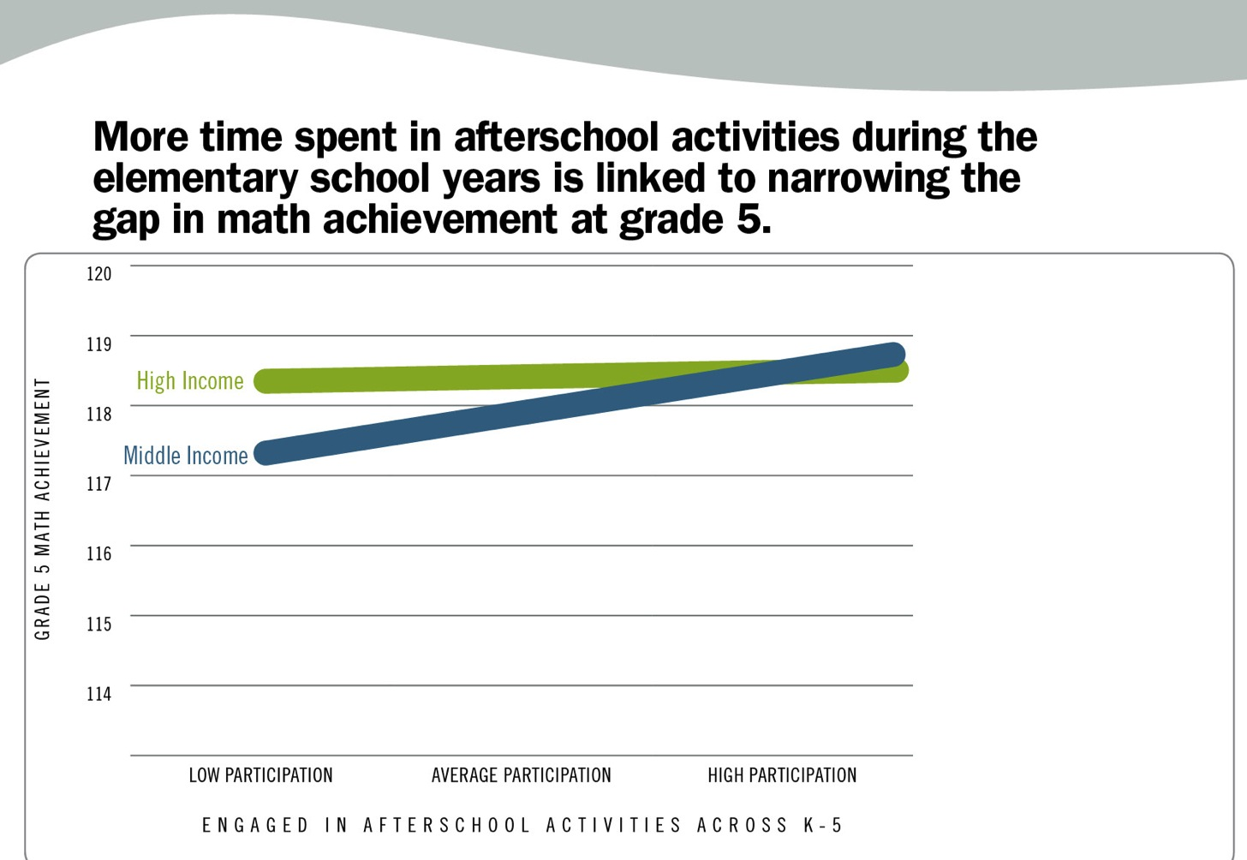
Notes:
Eric:
We see slight gains for middle income students, which catches them up with high income students.

Slide 27
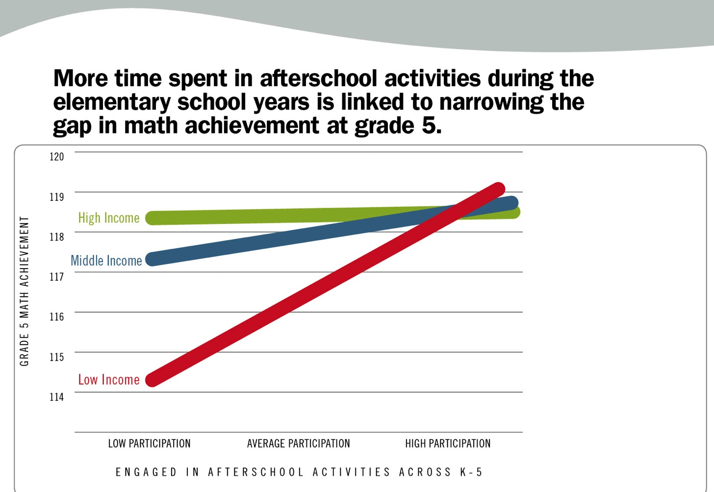
Notes:
Eric:
But the largest impact is for low income students. The gap in Math scores disappears with high participation!

Slide 28
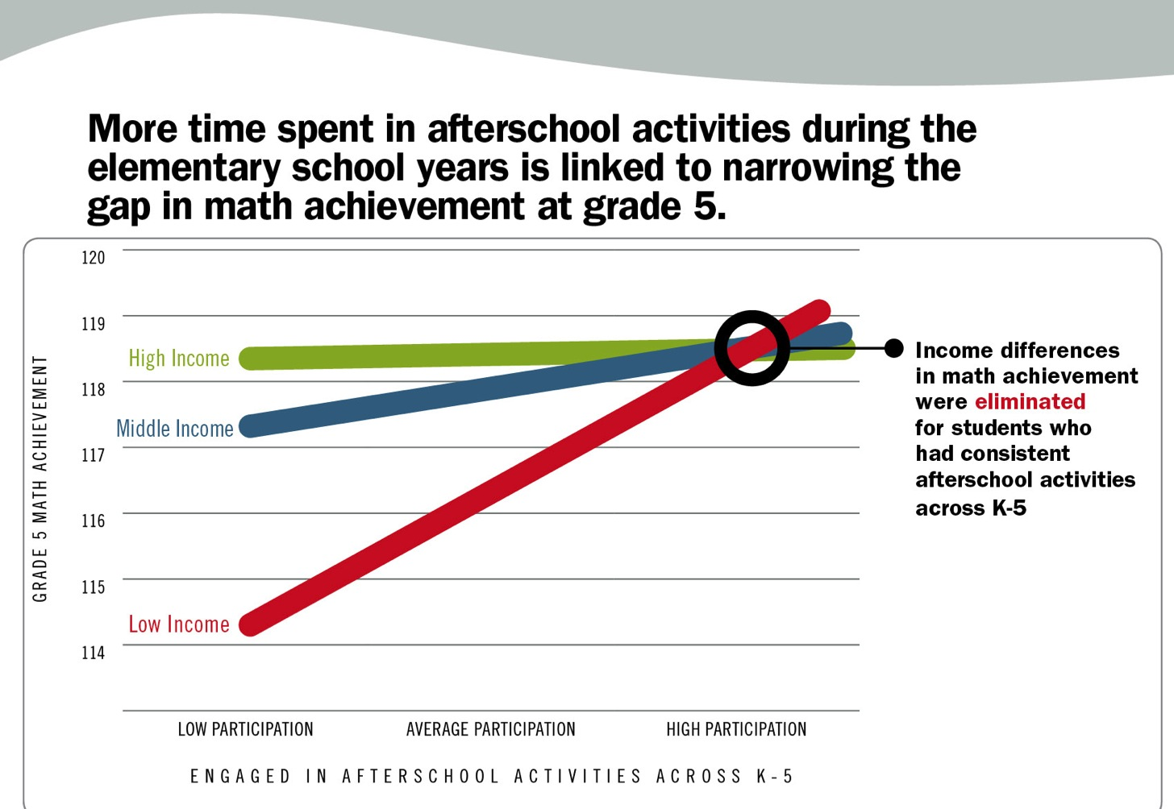
Notes:
Eric:
This study found the program did not need to be an intentional Math program for the impact. It could have been anything from STEM to dance programs. Other studies have found that with intentional Reading interventions, the same holds true for Reading scores.

Slide 29
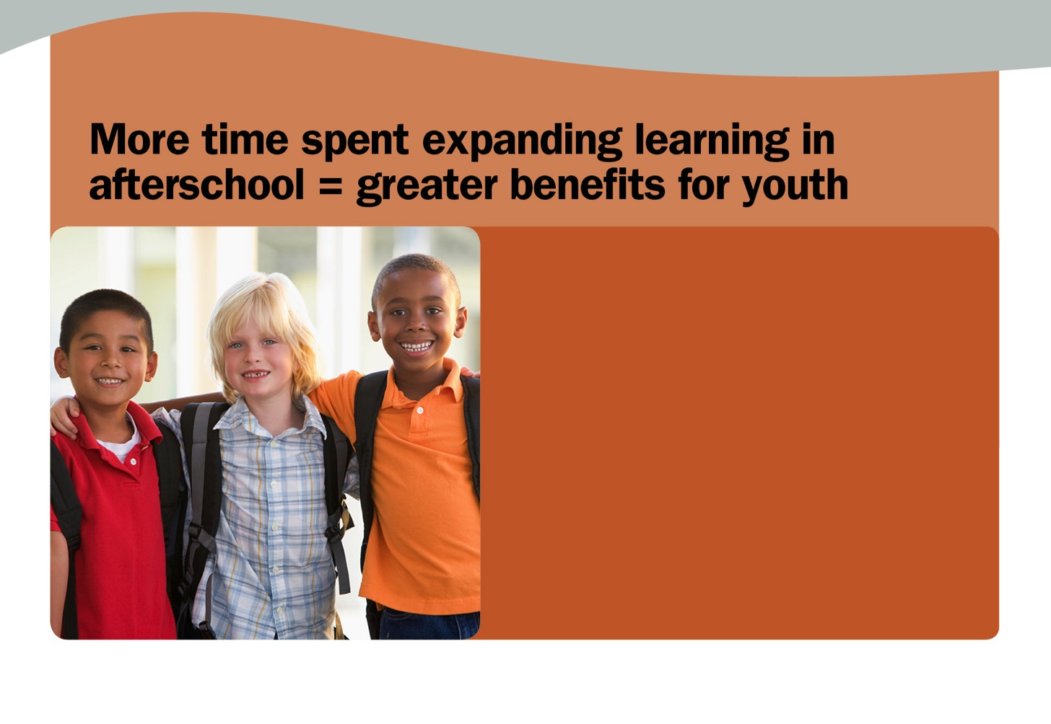
Notes:
Eric:
So we know the amount of time in a high quality afterschool program matters to see positive outcomes.

Slide 30
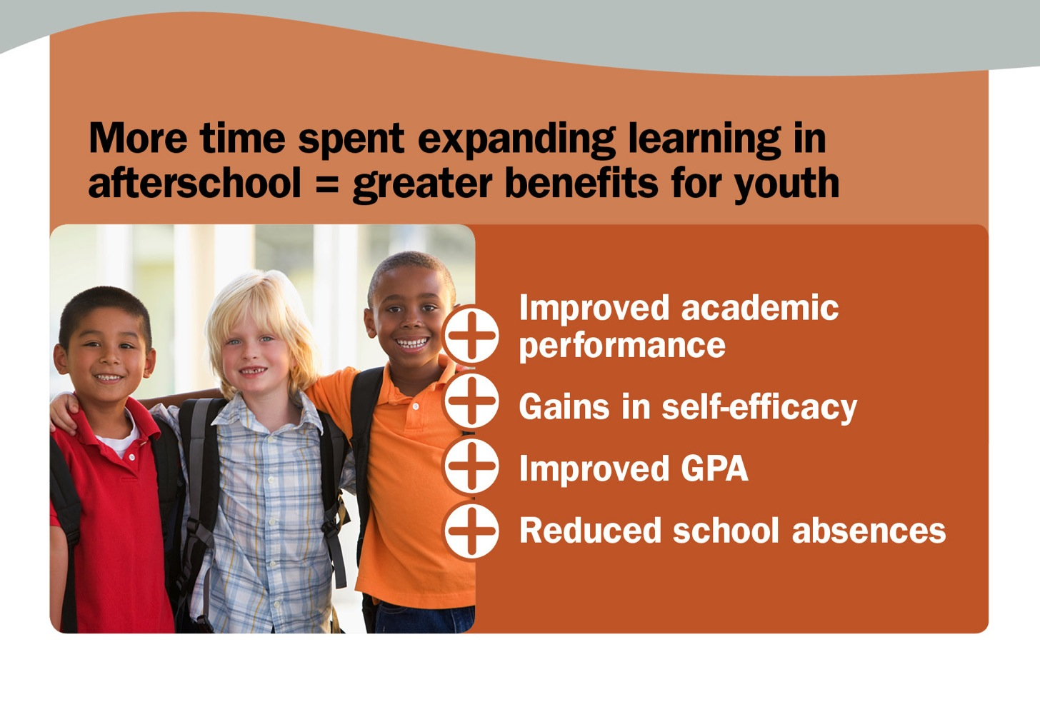
Notes:
Eric:
Without being centered on a particular curriculum. So what makes the difference?

Slide 31

Notes:
Eric:
Research suggests the gains happen when young people are having positive experiences with caring adults…

Slide 32
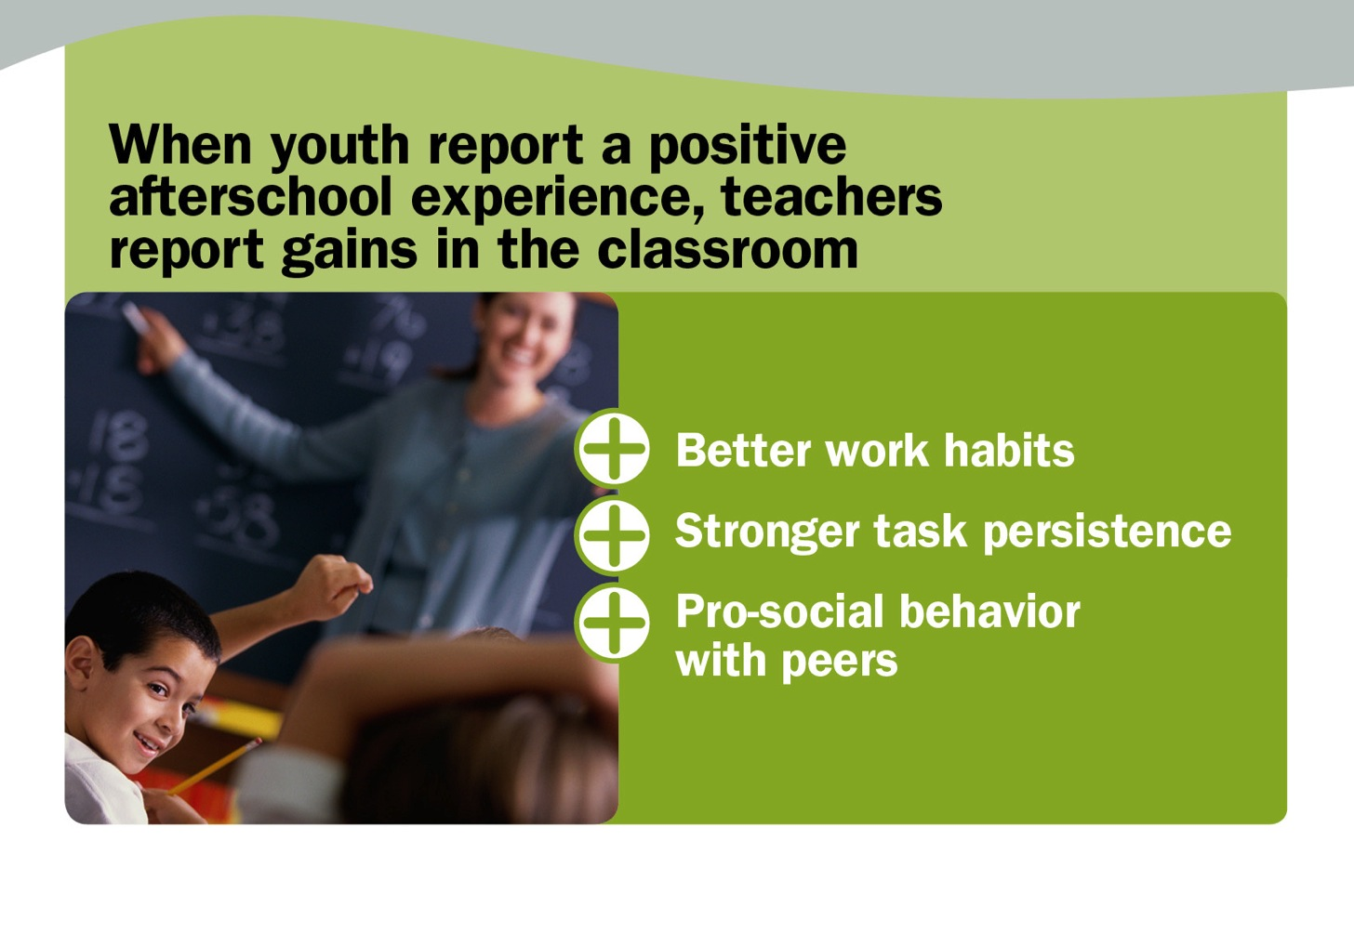
Notes:
Eric:
… they gain social and emotional skills which carry over into the school day.

Slide 33

Notes:
Eric:
These slides are used with permission from Deborah Lowe Vandell. She provided them to the Statewide Afterschool Networks to support their mission. For more information about her research, please visit www.afterschooloutcomes.org.
There is new research coming from the Weikert Center for Youth Program Quality and Susan Crowne Exchange is linking the SEL skills learned that are leading to these outcomes.

Slide 34
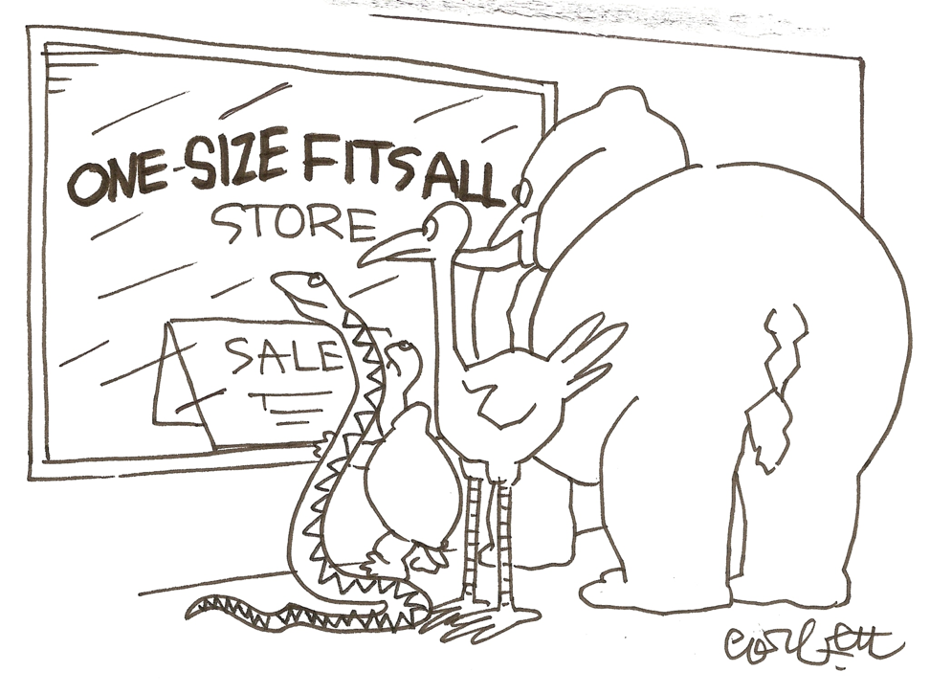
M³ Design Features
youth &
family population
culture &
geography
program
focus
relation with
staff/board
funding
requirements
structure &
resources
history with
evaluation tools
previous
action plans
Notes:
Maira:
A primary consideration that was taken into account during the designing of M³ is that Context Matters.
M³ recognizes that programs and sites across the state are very different and a one-size approach to continuous program improvement will NOT fit all.
Data that comes from one program that is identical to data taken from another program could have entirely different meanings based on context.
Each of you live and operate daily in very different worlds.
Your context matters, all your work is framed in that every day, all day.
That is why M³ provides a series of Making Meaning questions for teams to consider that can take into account their context as they review their data.

Slide 35




Design Feature: Tool Neutral
QUALITY
PRACTICES
YPQA, NYSAN, APT, organization capacity scales, BiBi Building Blocks of Effective Practice self-assessment, Quality Mentoring Assessment Path, HOST assessments
ATTENDANCE/
PARTICIPATION
City Span, KidTrax, CTK, EZ reports, OYP, spreadsheets
PROGRAM
EXPERIENCES
Parent and youth satisfaction surveys, focus groups,
SAYO-Y (experience scales)
Internal evaluation tools, SAYO-Y (outcome scales), SAYO-S, SAYO-T, academic test scores, school discipline reports, behavior monitoring sheets
YOUTH
OUTCOMES
Notes:
Maira
And finally, M³ is tool-neutral. There are many different ways to gather the data you need for program improvement.
Here are the sets of data and some examples of sources/tools programs have used to measure:
(click)
Quality practices: Data/info used to assess your program's use of quality afterschool practices. Examples are YPQA, APT, NYSAN, organization capacity scales, Quality Mentoring Assessment Path.
(click)
Program experience: Program experience data represents information that speaks to how your participants experience the program from their perspective. This could include surveys, focus groups, etc. parent and youth satisfaction surveys, focus groups, SAYO-Y
(click)
Attendance/participation: Attendance log or database tracking participation of youth in your program.
(click)
Youth outcomes: Data/info that shows the outcomes (academic, social-emotional, etc.) of your program participants or community outcomes.
M³ is a 6 hour workshop where teams from an afterschool program or youth serving organization go through a facilitated process in each set of data individually first.
Participants look at what the data says and then move through a series of reflection questions to help them make meaning and identify opportunities for action.
Then we un-silo them and put all 4 areas up on a wall and see where some opportunities to converge emerge.
Finally teams make decisions about where to focus – big and small, short term wins and longer term items, stand alone in each area and issues that cross multiple areas – and action plan.
Another benefit of the process, is that participants are understanding the difference between quality, outcomes, outputs, etc…

Slide 36
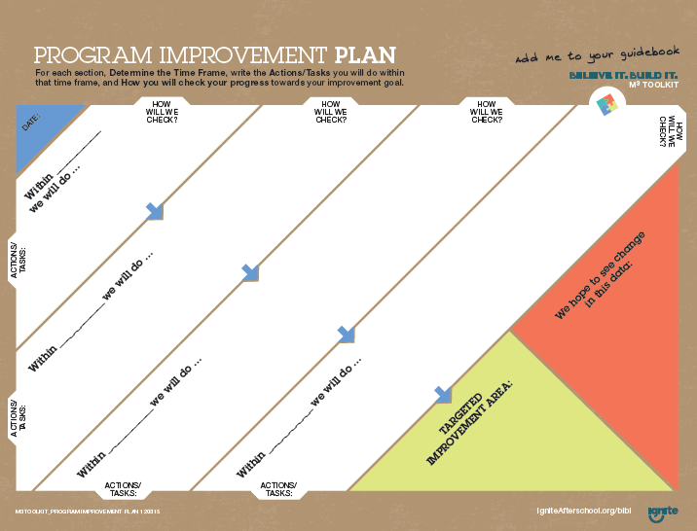
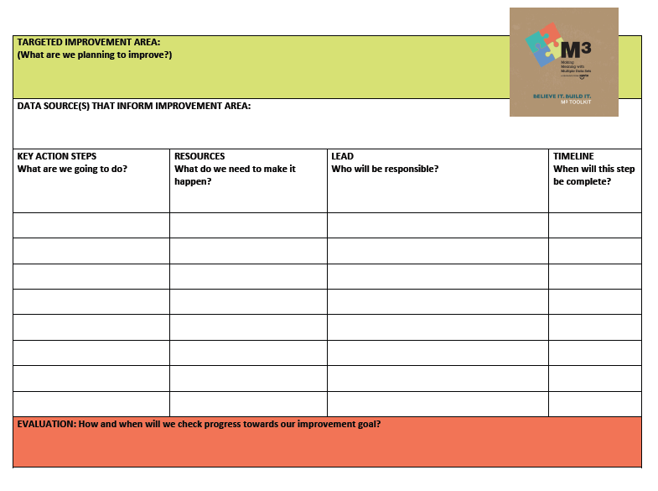
Planning for Improvement
  Program Improvement Plans
    Template Examples
    “Stand-Alone” Areas and Convergent Issues
    SMART Goals
    Share with Stakeholders
Notes:
Maira:
Action Plans
Improvement Plan Templates: choices for M³ process: Basic, Advanced or internal organization or system plan. They choose which template to use based on their needs and context
Teams should create one complete improvement plan for each “stand-alone” area for improvement or convergent area for improvement chosen during the M³ process.
Refer to SMART Goals & Strategies for Action – resources on creating good action plans in folders.
Participants are encouraged to consider when and how they will share their improvement plan with staff and stakeholders at their organization to engage those not in attendance.

Slide 37


Oh so true! I’d marry it if I could.
True, true – but not an obsession.
I see value – but prefer to live in a
different world.
Yeah – not so much.
Not for me, not for my world.
No need to say anything more.
Notes:
Eric:
Remember when we said a goal of the M³ was evaluation capacity building? This is an exercise we do with program folks at the beginning of M³.
We do a quick check at where this group is with evaluation and data collection.
Where are you at in agreement with the statement: I Love Data?
Hold up a finger:
(click)
0 = No need to say anything more
1 = Not for me – not for my world
2= Yeah…not so much
3 = See the value – but prefer to live in a different world
4 = True, true but not an obsession
5 = Oh so true! I’d marry it if I could
What’s important to know, is that the groups of folks at M³ were really evenly distributed when we asked this at the beginning of our sessions. Probably leaning toward the lower end. Many people were actually pretty nervous being at a workshop for evaluation. Which makes the following data more impressive.

Slide 38
M³ Data
Notes:
Eric:
68 participants in 2015 (response rate of 83%)
82% learned to consolidate multiple sets of data
88% gained tools to facilitate M³ discussions with teams back at their organization
71% identified next steps and improvement action items.

Slide 39
M³ Data
Notes:
Eric:
96% reported the Content Good or Excellent
95% reported the Resources as Good or Excellent

Slide 40
M³ Data
Notes:
Eric:
94% reported increased evaluation knowledge
86% reported new evaluation skills
96% reported planning to try something new

Slide 41
M³ Data
“I think a lot of good will come from today for my program.”
“Now I understand the reason and importance of the data collecting.”
“Data can be fun!”
“I’m truly excited about how this data can be used to help our programming!”
“I am more knowledgeable about data and evaluation.”
Notes:
Eric:
The numbers really don’t capture the comments we heard after the events. So many people were excited. The confidence about using evaluation was so high. It was really inspiring to be part of the process.

Slide 42
Today you will…
  Meet Ignite Afterschool
  Overview M³
  Identify Action
  Meet Ignite Afterschool
  Overview M³
  Identify Action
Notes:
Eric:
We have introduced you to Ignite Afterschool and given you an overview of M³.
Any surprises?
Any “ah-ha”s or “I hadn’t really thought about that”s?
How might you use Ignite Afterschool’s M³?
Any questions?
(click)
Let’s wrap up our final learning objective by giving you some time to think about how to create action around continuous program improvement and M³ in your programs and organization.

Slide 43
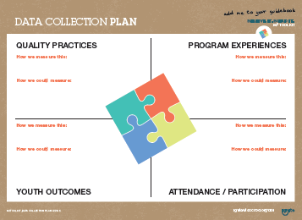
Notes:
[Eric distribute Data Planning Worksheets].
Maira:
As you prepare for M³, we want to give you a chance to identify what you are collecting and with which tools.
Sometimes one tool collects things in a few different buckets. And sometimes we haven’t mentioned a tool you are using to collect data.
After you complete the form, turn to a neighbor to talk about what you collect and what do you need to start collecting.

Slide 44

Finding Validated and Reliable Tools
Notes:
Maira:
As you think about other tools you might need to collect data, here are a couple free publications from the Forum for Youth Investment with validated tools for measuring quality, experiences, and outcomes.

Slide 45
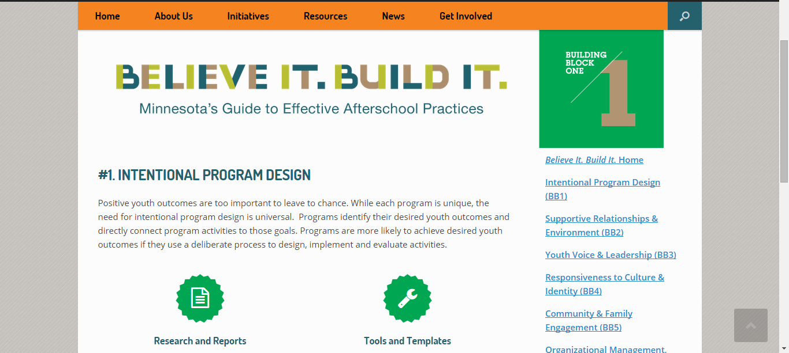
Believe It. Build It. Online
Notes:
Eric:
You can also find resources on the Ignite Afterschool website.

Slide 46
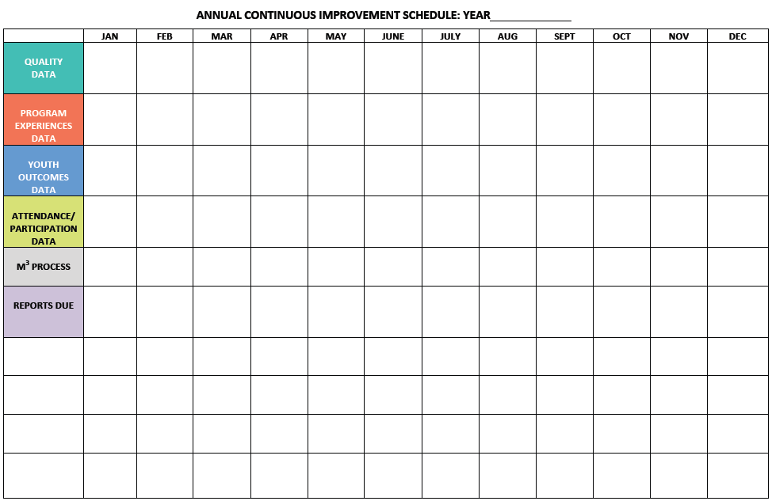
Notes:
Maira:
Introduce template for Annual Planning for Continuous Improvement – cycle, when collected, when analyzed, when action-ed, etc.
Template for Annual Planning for Continuous Improvement – what's your cycle? when collected? when analyzed, when implemented? Etc.
Data collection for sets – when is each collected? When are results available? When will Making Meaning happen? Annually? Every 6 months?

Slide 47
Notes:
[Flip over Data sheets, Blueprint for Action sheet on back]. Take a few minutes to fill the sheet out and then we will do some sharing to get additional inspiration from our colleagues.
Eric:
10 minutes:
Ask for a final large group debrief in the last 10 minutes:
Based on both previous experiences and today’s experience, what are important things to consider or remember when thinking about building and using CPI processes in your programs and organizations? [**Hit the following points at some point in discussion]
When we have conversations about “quality” sometimes we or our partners, youth workers, staff can get exasperated that we’re asking them to reach perfection. But that’s not what this is about.
Program quality is not an end goal – it’s a process that needs continuous attention.
You can use different data or observations in the “checking” process – from your own observations, to youth surveys, to assessment tools
You can involve different people in your “planning” discussions – frontline program staff, youth, parents, or community members
Would you feel confident undertaking this process in your program?
What supports or resources do you need within your organization/program to make this process more concrete or accessible to you?

Slide 48
Today you will…
  Meet Ignite Afterschool
  Overview M³
  Identify Action
  Meet Ignite Afterschool
  Overview M³
  Identify Action
Notes:
We have introduced you to Ignite Afterschool and given you an overview of M³. Let’s wrap up our final learning objective by giving you some time to think about how to create action around continuous program improvement and M³ in your programs and organization.
Any surprises?
Any “ah-ha”s or “I hadn’t really thought about that”s?
How might you use Ignite Afterschool’s M³?
Any questions?
In the large group, say 1 word or 1 sentence about how you are feeling or what you will take away from today’s session.

Slide 49
Thank you! Stay in Touch
  Eric.Billiet@state.mn.us
  Maira.Rosas-Lee@state.mn.us
  www.IgniteAfterschool.org
  Twitter: @IgniteMN
  Facebook: Ignite Afterschool
Notes:
Thanks for committing time today to move through this resource and committing time tomorrow and beyond to doing the best you can and them doing better for positive outcomes for youth.

Slide 50
If folks want to get onto Ignites email list, they can go to this link http://igniteafterschool.org/get-involved/subscribe/
(It is accessible through the website (igniteafterschool.org) under ‘contact us’ there is a “subscribe to email list” button.)

